Slide 1

MLDE2021 Spring Semester
Project 2022
12.04.2022
RESLA
Juhani Vanhatapio, Tuomas Pasanen, Makarov Nikita, Adewunmi Obajimi,
Vincenzina Soös

Slide 2
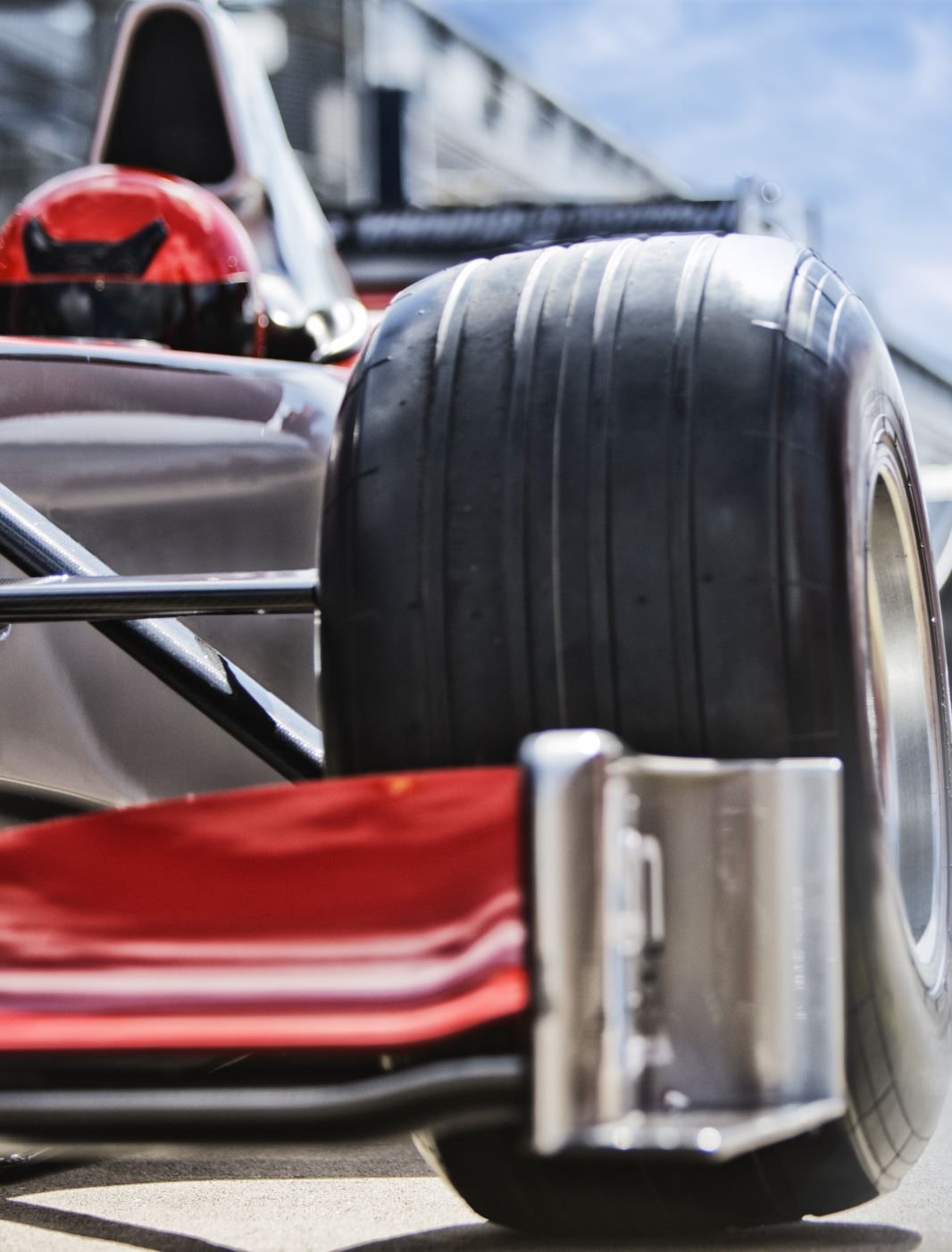
Background
Ensure the RC car move on Arduino (codes)
Driving via IoT, Bluetooth, ESP32 and Raspberry pi
Controlling via webpage
Testing

Slide 3
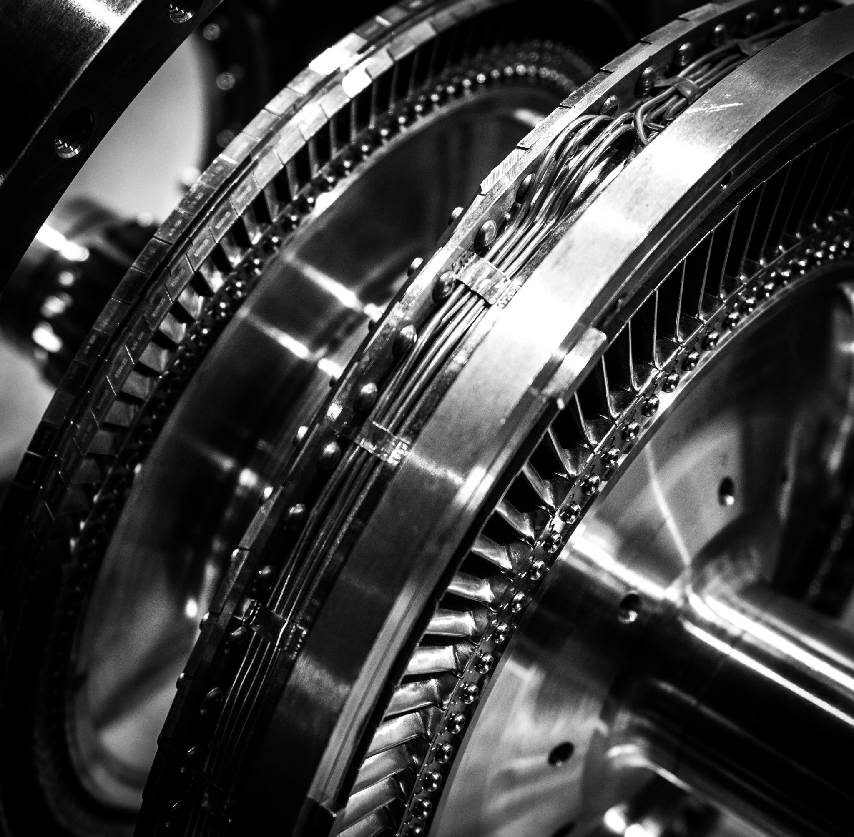
Componets/Parts
Power bank
Battery
Raspberry pi
Breadboard

Slide 4
Actions
RC car moved foward , backward , turned left and right.
Also, stop via command.

Slide 5
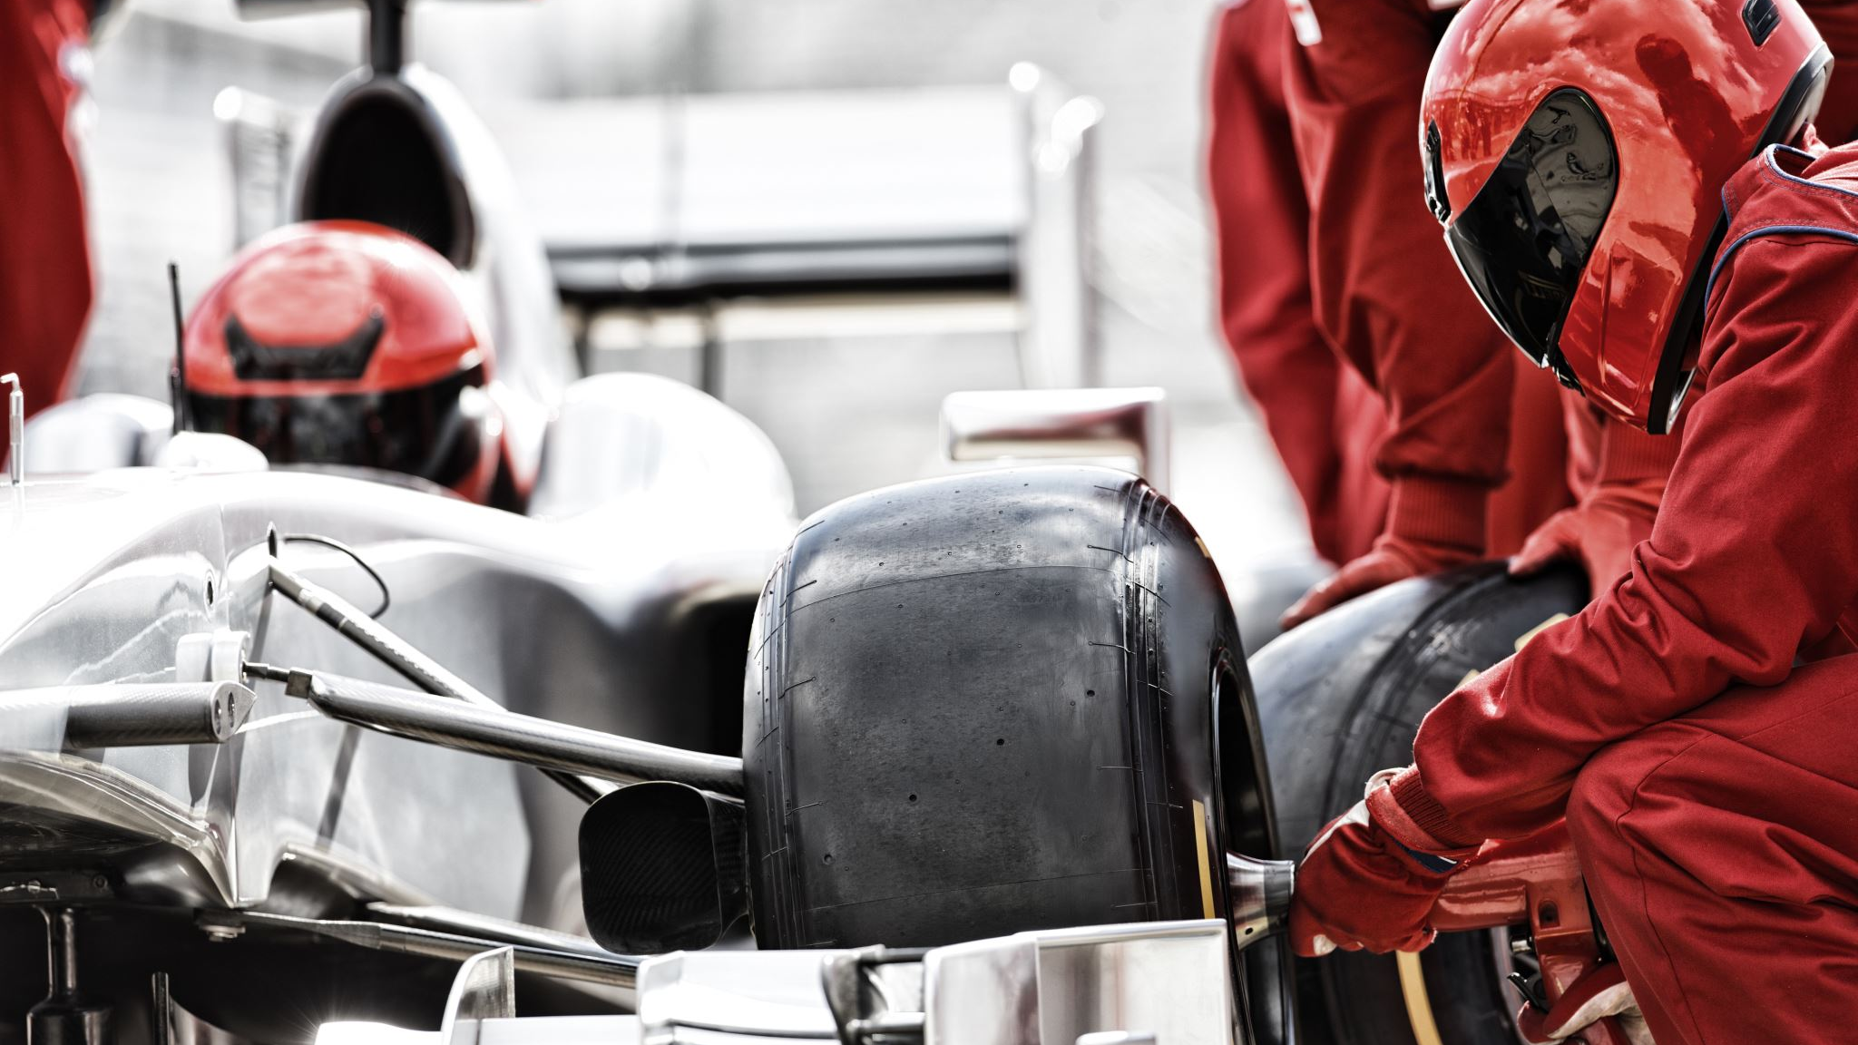
Driving The RC Car
The car moves straight from the raspberry pi via the command line.
And using python 3 codes.

Slide 7
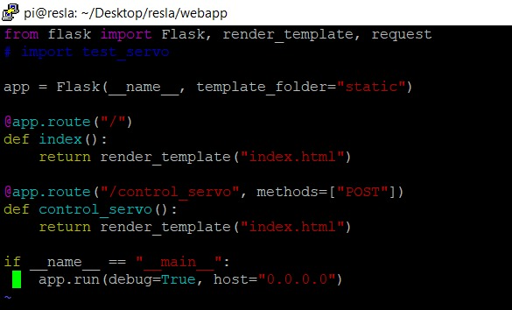

Slide 8
